Slide 1
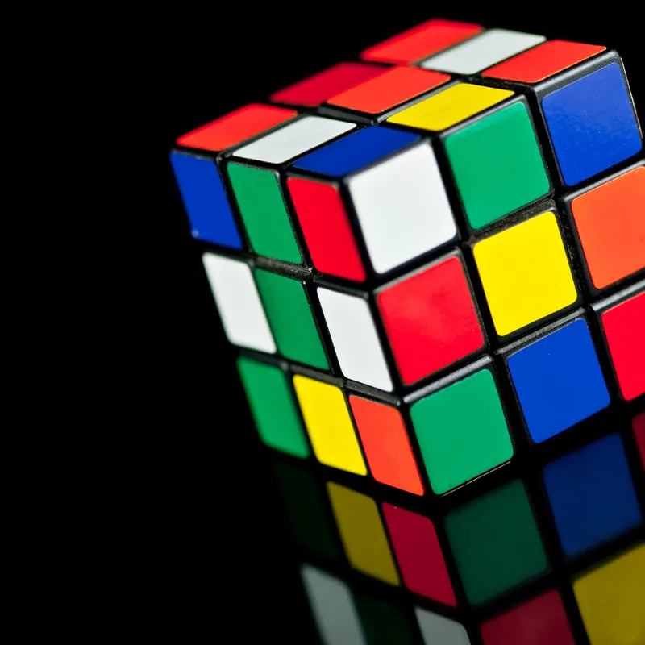
Rubik’s cube
Best Solution In Minimal Effort
Eldor Mouyal
Omer Dor
Saja Jbareen

Slide 2
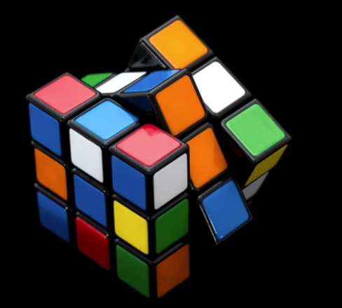
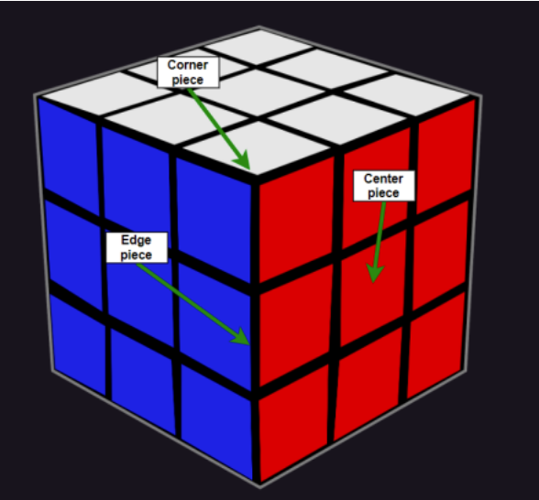
A little about the cube..
Notes:
A 3-D combination puzzle, was invented by Hungarian architecture professor "Ernő Rubik". -
It usually contains 6 colors, one for each face: white, red, blue, orange, green, and yellow. -
- It is made of 27 smaller cubes, where we can see 3 faces of the corner pieces, 2 faces of the edge pieces, and 1 face of the center pieces.

Slide 3
Notations Of Solution
https://solvethecube.com/notation
Notes:
Face Rotations:
F (Front) - the side currently facing the solver.
B (Back) - the opposite side of the Front.
U (Up) - the side above or on top of the Front side.
D (Down) - the side opposite of the Top, underneath the Cube.
L (Left) - the side directly to the left of the Front.
R (Right) - the side directly to the right of the Front.
Slice Turns:
M (Middle layer turn) - direction as an L turn, between R and L.
E (Equatorial layer) - direction as a D turn, between U and D.
S (Standing layer) - direction as an F turn, between F and B.
Whole Cube Rotations:
X - direction along the x-axis.
Y - direction along the y-axis.
Z - direction along the z-axis.
Prime symbol ( ′ ) after a letter indicates an anticlockwise face turn , while a letter without it denotes a clockwise turn.

Slide 4

The problem
You don’t know where to start solving the cube.
You want the solution as quickly as possible.
You want the solution with minimal effort.
You want to impress your friend with a nice program.

Slide 5
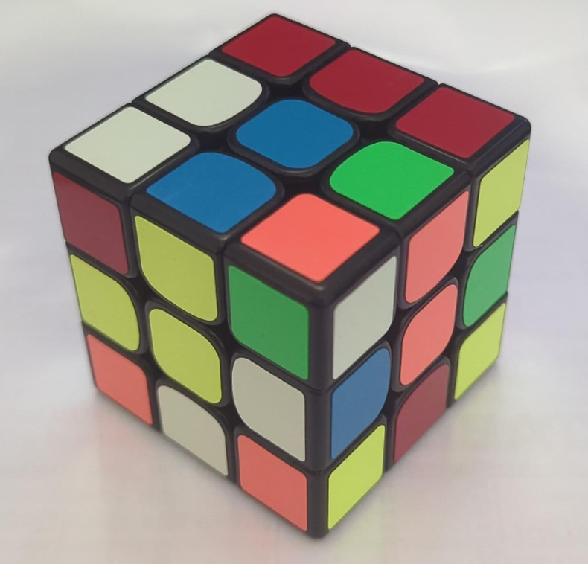
OUR METHOD
6 main steps :
Edge Detection.
Line Detection.
Line Filtering.
Color Identification.
Input String Generation.
Cube Solver Execution.

Slide 6
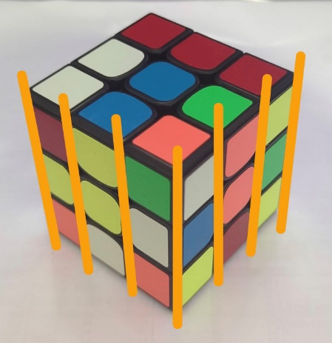
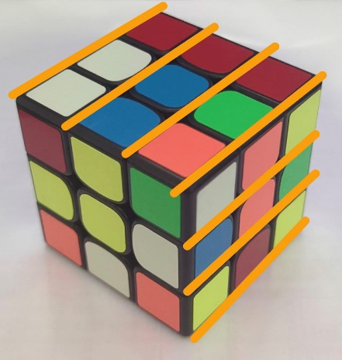
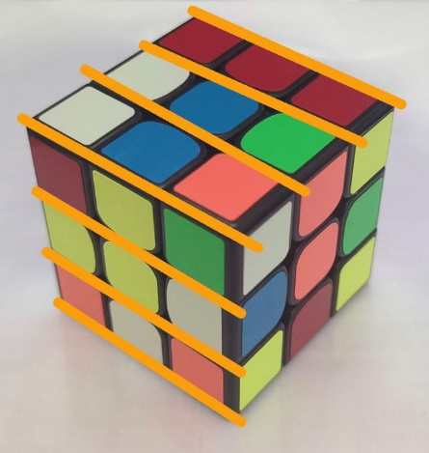
classification of contour lines
Contour lines are divided into three groups, according to their angle relative to y axis :
1. Lines forming vertical angles (approximately 0 degrees)
2. Lines forming sharp angles (approximately 60 degrees)
Lines forming obtuse angles (approximately 110 degrees)
Notes:
Second image – sharp angle
Third image – obtuse angle

Slide 7
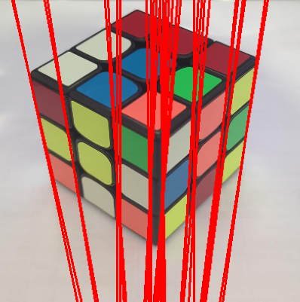
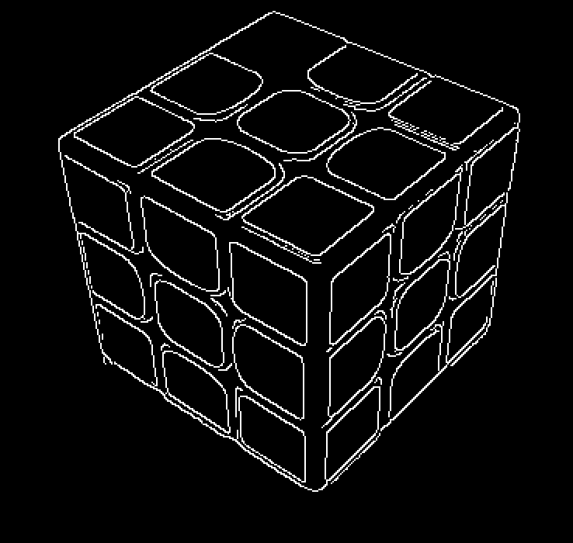
Line detection
We read the images in grayscale (for this step only!)
We experimented to determine the optimal thresholds for the Canny Edge Detector and Hough Line Transform
We applied the Canny Edge Detector to detect edges in each image
We utilized the Hough Line Transform to identify lines in the edge-detected images for finding every group of lines.

Slide 8
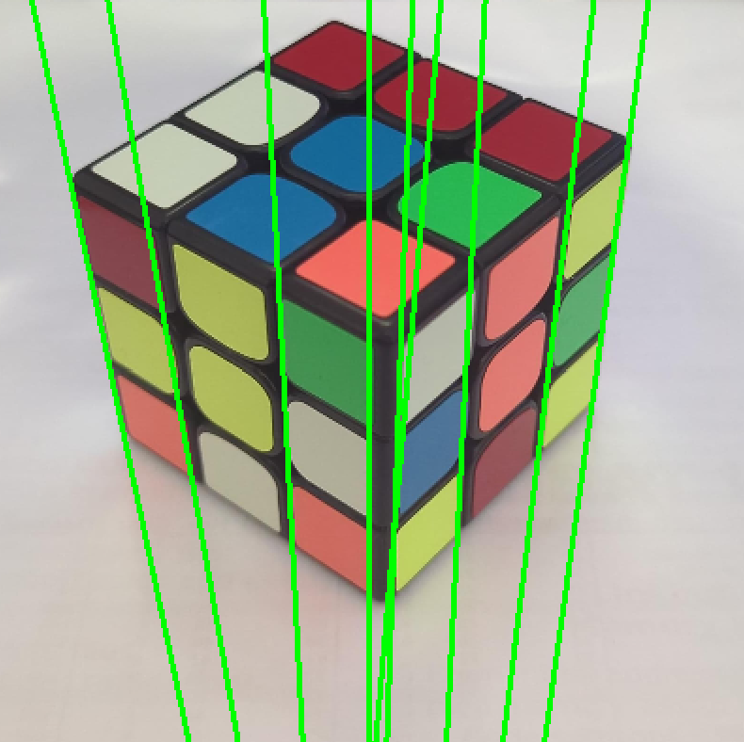
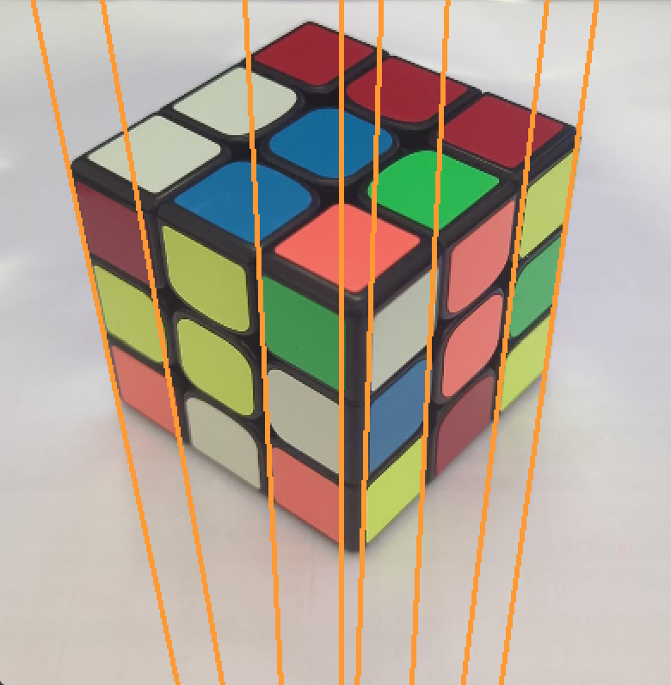
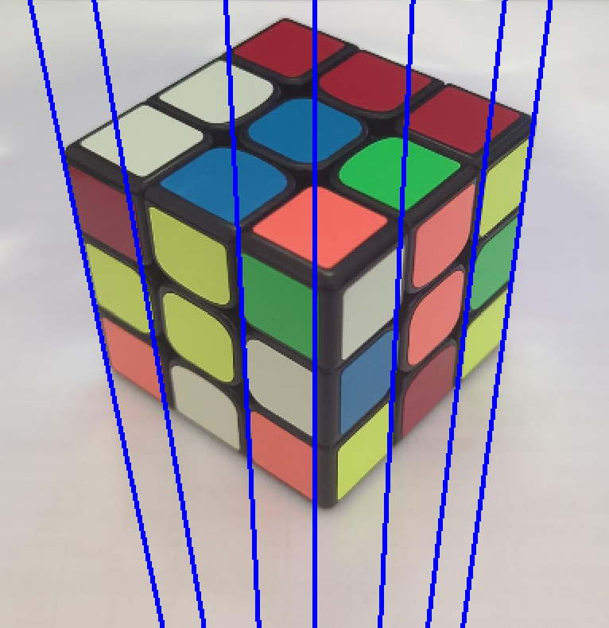
CLUSTERING LINES
We applied initial filtering to the group of lines obtained from the Hough Line Transform based on the parameters specific to each line.
Following the first filtering process, we employed another filtering process based on the distances between lines to select lines that best represent the faces of the cube.

Slide 9
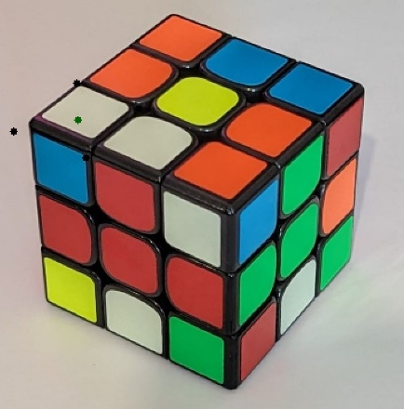
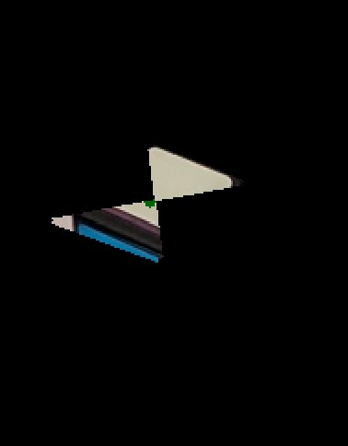
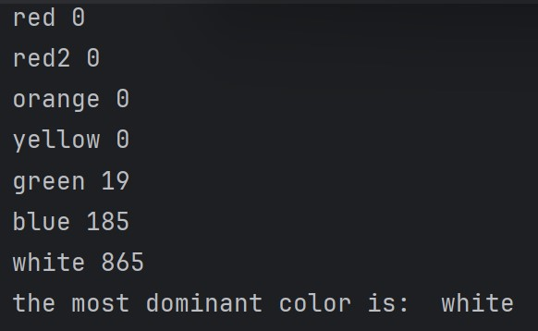
Color Identification
We calculated the crossing points of the contour lines.
We obtained the ROI (Region of Interest) for every square on the cube (and rhombus in the image).
We converted it to HSV color space and counted the pixels for every color of the cube in the ROI to determine the most common color within it.
We repeated this process for every square on the faces of the cube.

Slide 10
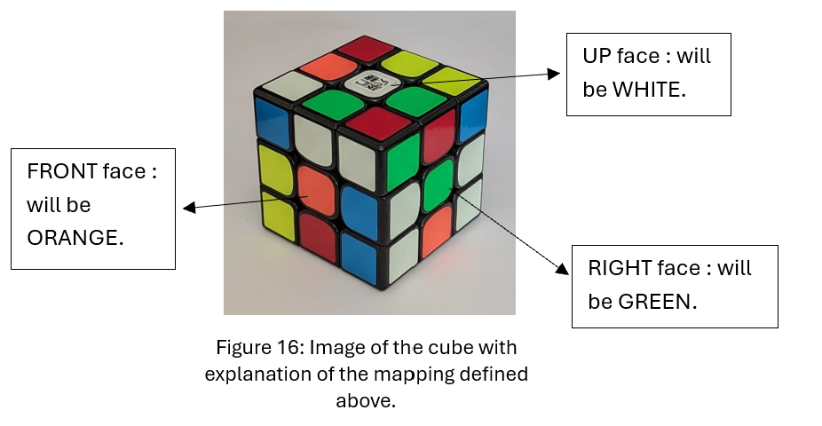
Input String Generation
The string is constructed as follows: for each face, we identify the color of the middle square.
Then, by iterating through all squares on all faces and following the mappings, we determine the letters in the input string.
Notes:
In the first image:
The face oriented upwards becomes our UP face.
The face oriented to the left becomes our RIGHT face.
The face oriented to the right becomes our FRONT face.
In the second image:
The face oriented upwards becomes our DOWN face.
The face oriented to the left becomes our LEFT face.
The face oriented to the right becomes our BACK face.

Slide 11
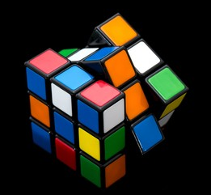
Cube Solver Execution
For solving the cube, we utilized a Python package that implements Kociemba' s Algorithm, a renowned method for solving Rubik’s Cube.
This algorithm is divided into two phases.
The first phase concentrates on independently solving the cube's corners and edges, while the second phase manipulates the cube's remaining pieces to achieve the final solved state.

Slide 12
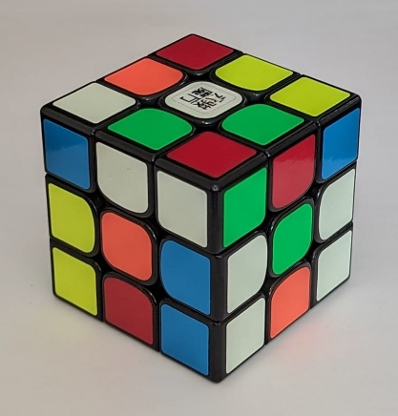
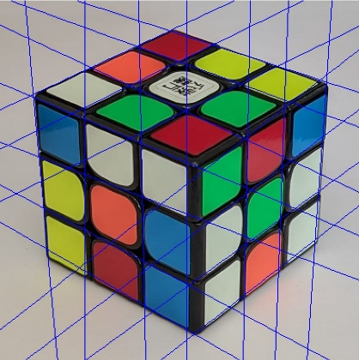



Result
UP
RIGHT
FRONT

Slide 13
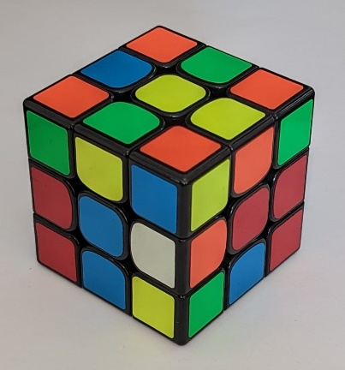
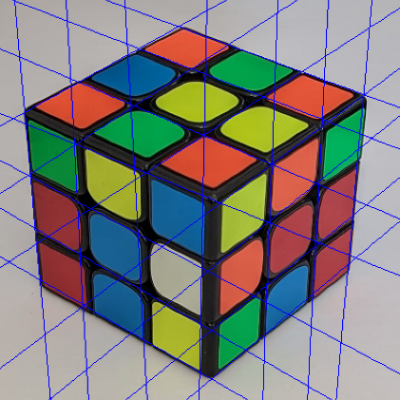



Result
DOWN
LEFT
BACK

Slide 14
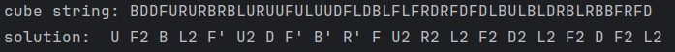
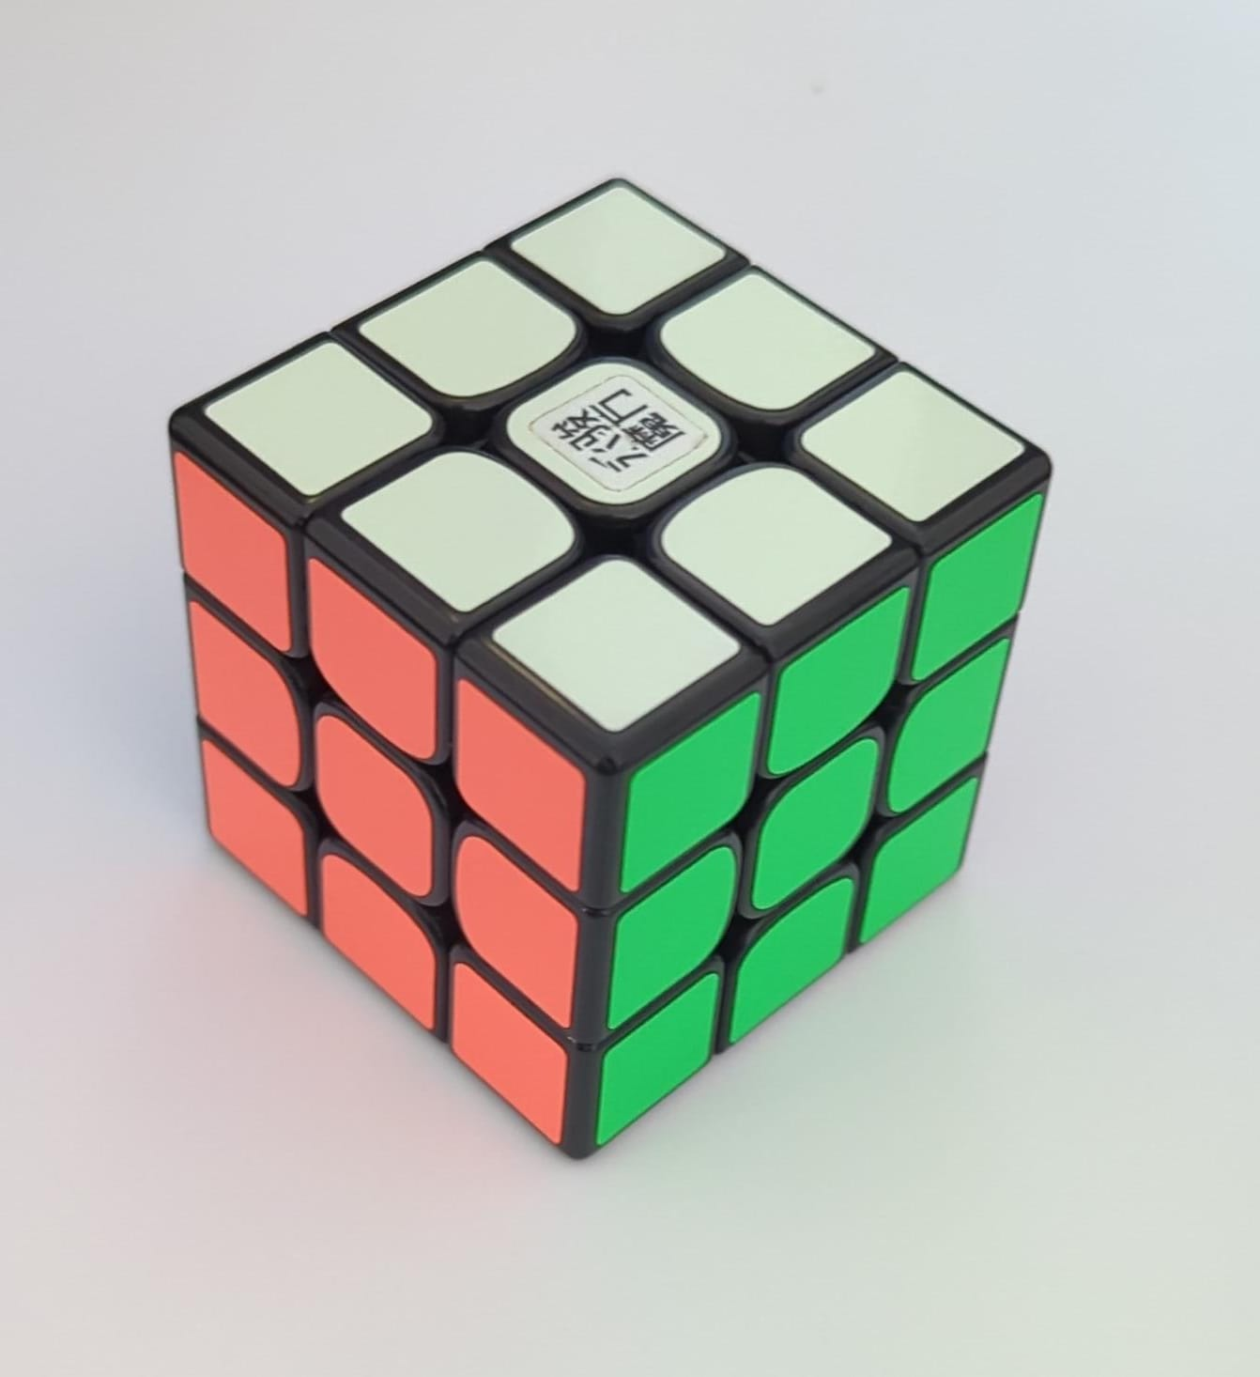
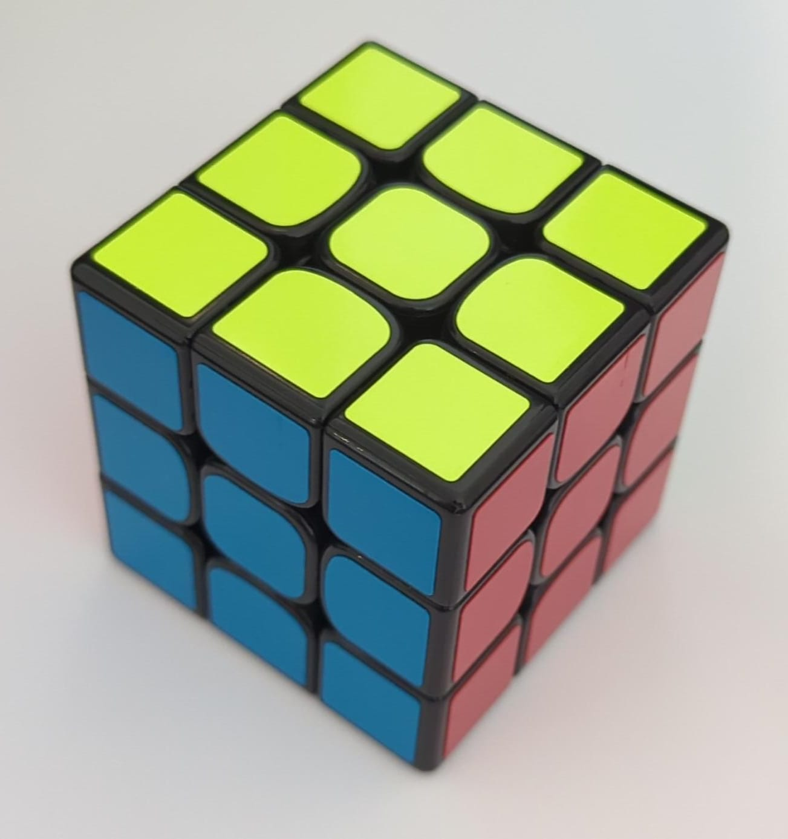

Slide 15
Points for improvement
Ensure robust handling of images with shadows.
Accommodate images with rectangular shapes.
Handle cubes where the base color is not black.
If the preprocessing of the images is not performed effectively, the squares on the faces of the cube may not be properly identified.
Develop a method for finding a consistent threshold that is suitable for various images.
Improve the accuracy of the lines representing the faces of the cube.

Slide 16
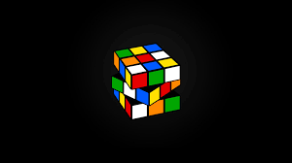
THANK YOU!

